Slide 1
Concrete Strength Project
By
Hamzah
Yousef
And Sahel

Slide 2
Constituents Of Concrete
•Water
•Aggregate
•Portland Cement
The components of concrete are very important. The quality of each component determines how the concrete behaves under pressure and in different conditions. Varying the amount of the concentration of water can significantly alter concrete texture.

Slide 3
Model Explanation
Things that can into an effective model
Importing modules such as numpy, pandas, statistics, maplotlib, sklearn,
Modules have functions that make the completions of models much easier with their individual functions
Import concrete csv
The file should have a large amount of data with diversity. Importing a csv file that is of rich quality ensures our model is optimal and accurate
Data.info
This allows us to better gauge how the data will behave as it displays the data types present within the data.
Data.describe
This allows us to more effectively analyze the data with its statistics such as standard deviation and mean, maximum value and minimum value.

Slide 4
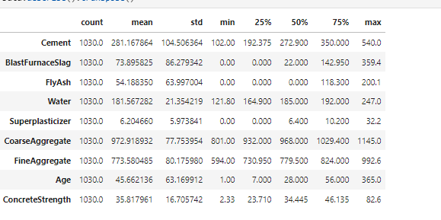

Slide 5
Model Explanation
Data=Data.dropna()
You can think of this function as a mechanism by which we clean the data to decrease the likelihood that we face errors when enforcing this model’
sns.pairplot(data)
This function allows us to see various relationships between different features/ independent variables present within the data. Their relationships present the different correlations found whether positive or negative

Slide 6
Correlations Found Among Different Features
Positive Correlation between cement and compressive strength. This makes a lot of sense because of the increased strength suggesting they are proportional
Super plasticizer and age are positively and strongly correlated with compressive strength.
Water has a negative and high correlation with super plasticizer,
Fly ash has a positive correlation with Fine aggregate.
The pairplot proves to be immensely beneficial in allowing us to see the unique relationships among the features present within the pairplot

Slide 7
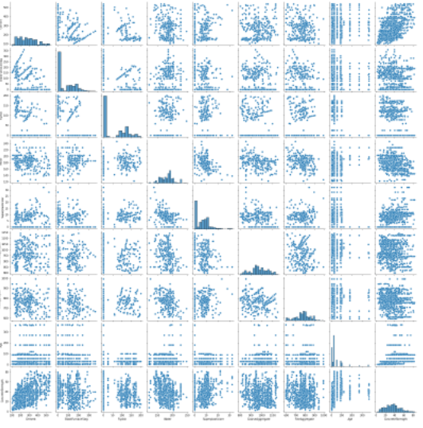

Slide 8
Correlations
corr = Data.corr()
sns.heatmap(corr, annot = True, cmap = ‘Blue’)
plt.title(“Feature Correlation Heatmap”)
This allows us to see how strongly correlated the different columns in this dataset are.

Slide 9
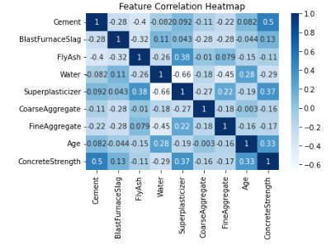

Slide 10
Assigning Values to Further Complete The Model
Values that are assigned into the predict array.
These values help us predict which regression model is ideal and further helps us with a more completed model

Slide 11
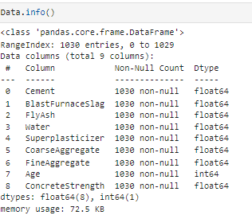
Data.info shows the data types present

Slide 12

Creating boxplot to further analyze the data.

Slide 13
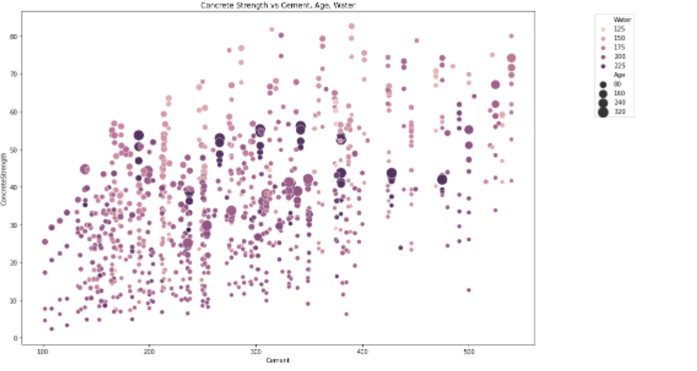

Slide 14
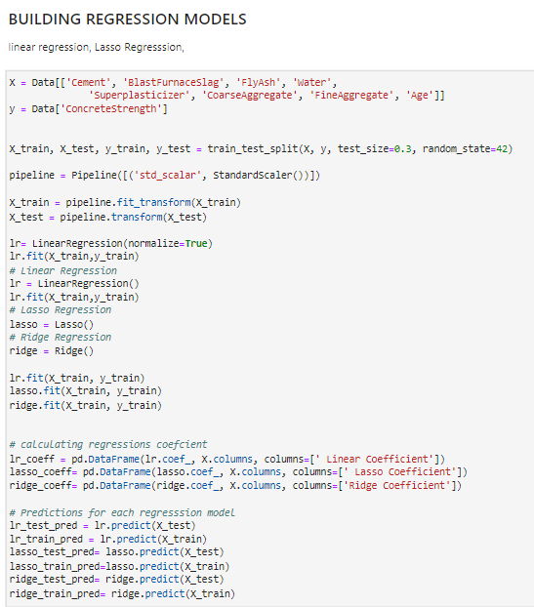
Building The Regression Model
Assign x values from data set
Assign y values from data set
Build a Regression Model(linear, lasso, ridge)

Slide 15
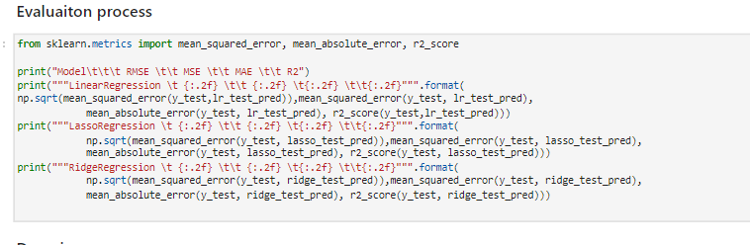

Slide 16
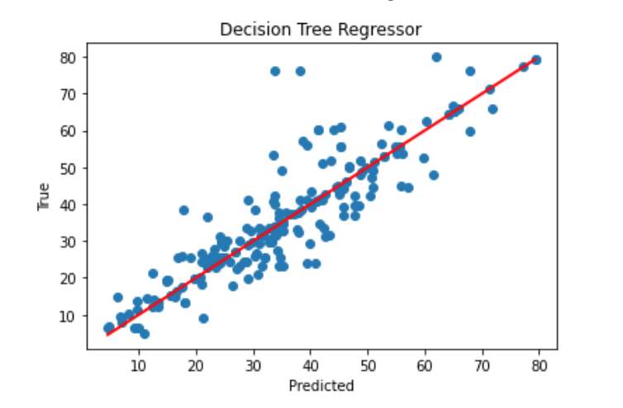

Slide 17
